Slide 1

Crime Data Analysis
Instructor : Dr. C.C Chan
Pradeep Thomas Yerramothu (py11@zips.uakron.edu)
Rishi Reddy Cheruku (rc81@zips.uakron.edu)

Slide 2
Datasets
Data Source : http://www.fbi.gov
Datasets:
U.S Crime Statistics for all the cities in every state from the year 2006-2012.
U.S Law Enforcement officials for all the cities every state from the year 2006-2012.

Slide 3
Problem Formulation(Re-visited)
Classify the cities and law enforcement officials with respect to type of crime each year.
Goal:
To ensure if there are sufficient law enforcement officers by state year by year.

Slide 4
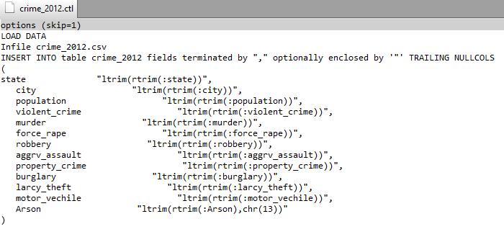
Data pre-processing
Migrated .csv files into Oracle Database by using an .ctl file and SQLLDR.
Ex: Sqlldr username/pwd control=crime_2012.ctl

Slide 5
Data pre-processing(Contd…)
Incompleteness and Inconsistency was found in the raw data.
Sorted out the Inconsistent Data by comparing the raw data and the data in the database.

Slide 6
Year | Crime Data | Law enforcement officers data | Records Considering
2006 | 8252 | 9933 | 7658
2007 | 8660 | 10143 | 8057
2008 | 8772 | 9915 | 8009
2010 | 9310 | 10208 | 8534
2011 | 9315 | 10055 | 8339
2012 | 9491 | 9605 | 8128
 |  |  | 48725

Slide 7
Data pre-processing(Contd…)
Grouped Cities in each state with respect to the population in that city.
Source: http://nces.ed.gov/
Type of City | Population
City | ≥ 250000
Suburban | ≥100000 and < 250000
Town | ≥ 25000 and < 100000
Rural-1 | ≥15000 and < 25000
Rural-II | <15000

Slide 8
Future Plan of Action
Cluster the data using WEKA
Visualize the data using OLAP by comparing year by year data
Get few patterns like crime in state year by year by creating a data cube.

